Slide 1
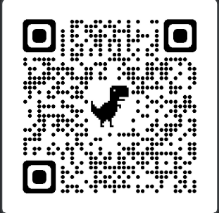
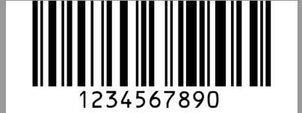
QR and barcode scanner

Slide 2
Libraries used:
OpenCV
NumPy
Pyzbar: to detect and localize barcodes and QR code.
Function under pyzbar : decode()
For detection, location and decoding the message of QR and barcode.

Slide 3
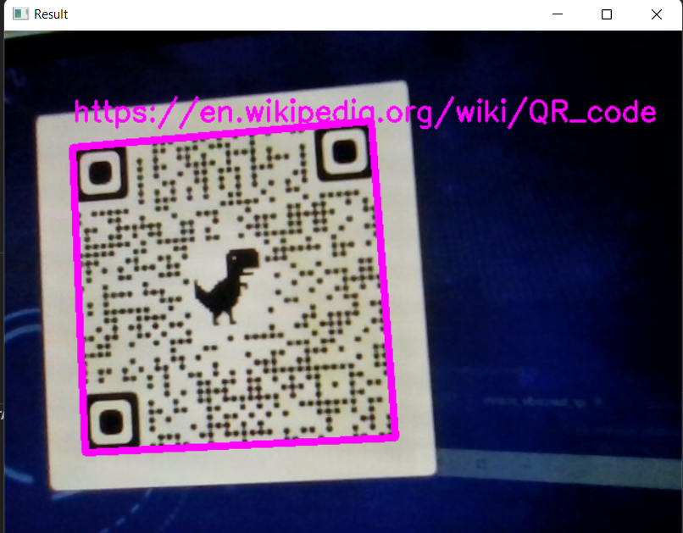
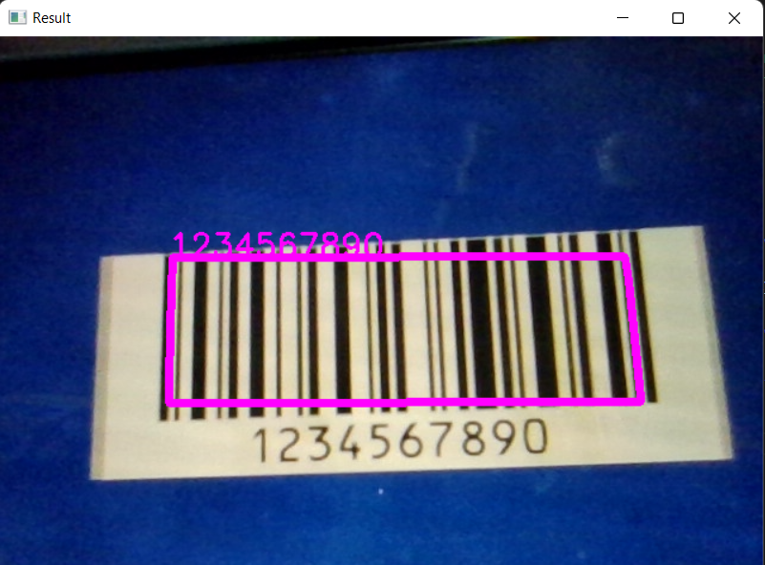

Slide 4
QR and Barcode Scanner Code:
import cv2
import numpy as np
from pyzbar.pyzbar import decode
cap= cv2.VideoCapture(0)
cap.set(3,640)
cap.set(4,480)
while True:
success, img = cap.read()
for barcode in decode(img):
myData = barcode.data.decode('utf-8')
print(myData)
pts = np.array([barcode.polygon],np.int32)
pts = pts.reshape((-1,1,2))
cv2.polylines(img,[pts],True,(255,0,255),5)
pts2 = barcode.rect
cv2.putText(img,myData,(pts2[0],pts2[1]),cv2.FONT_HERSHEY_SIMPLEX,0.9,(255,0,255),2)
cv2.imshow('Result',img)
cv2.waitKey(1)

Slide 5
Bounding polygon:
Steps:
convert polygon into array
np.array()
(Making a polygon instead of rectangle, so even if QR code is rotated it can detect properly.)
Reshape the array and send it to polygon function
reshape()
Polygon function:
cv2.polylines(img,[pts],True,(255,0,255),5)
(255,0,255)- color(magenta)
5 - thickness

Slide 6
To print out the message:
cv2.putText(img,myData,(pts2[0],pts2[1]),cv2.FONT_HERSHEY_SIMPLEX,0.9,(255,0,255),2)
myData -printing the data of the code
If polylines is used then text rotates as well.
pts2 = barcode.rect So we use top pts of the rectangle
cv2.FONT_HERSHEY_SIMPLEX –font
0.9 –scale
(255,0,255) -Color
2 -Thickness

Slide 7
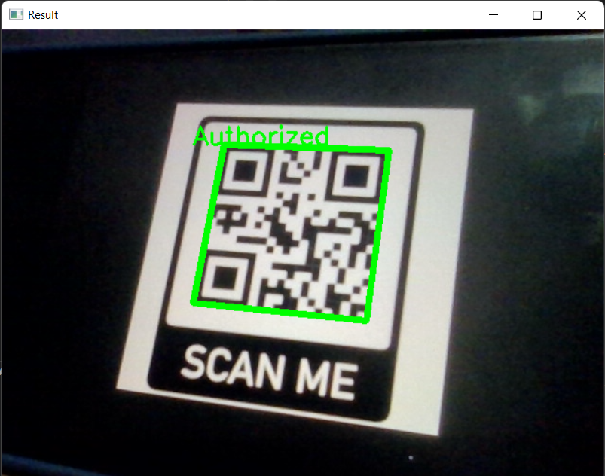
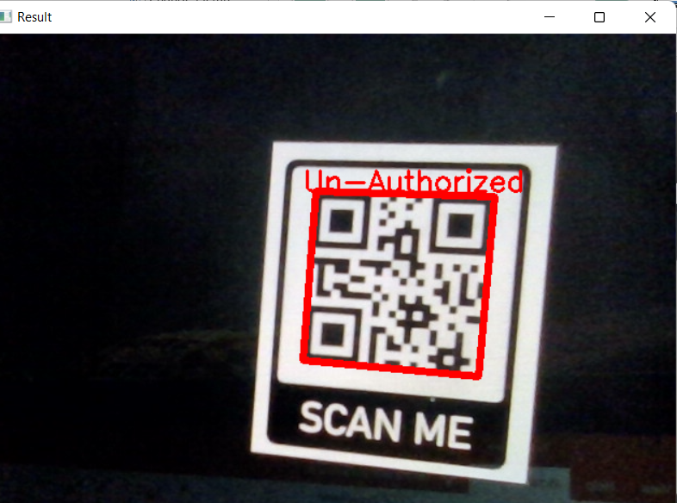
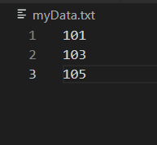

Slide 8
QR Code Authorization Code:
for code in decode(img):
myData = code.data.decode('utf-8')
print(myData)
if myData in myDataList:
myOutput = 'Authorized'
myColor = (0, 255, 0) # green
else:
myOutput = 'Un-Authorized'
myColor = (0, 0, 255) # red
pts = np.array([code.polygon], np.int32)
pts = pts.reshape((-1, 1, 2))
cv2.polylines(img, [pts], True, myColor, 5)
pts2 = code.rect
cv2.putText(img, myOutput, (pts2[0], pts2[1]), cv2.FONT_HERSHEY_SIMPLEX, 0.9, myColor, 2)

